Slide 1
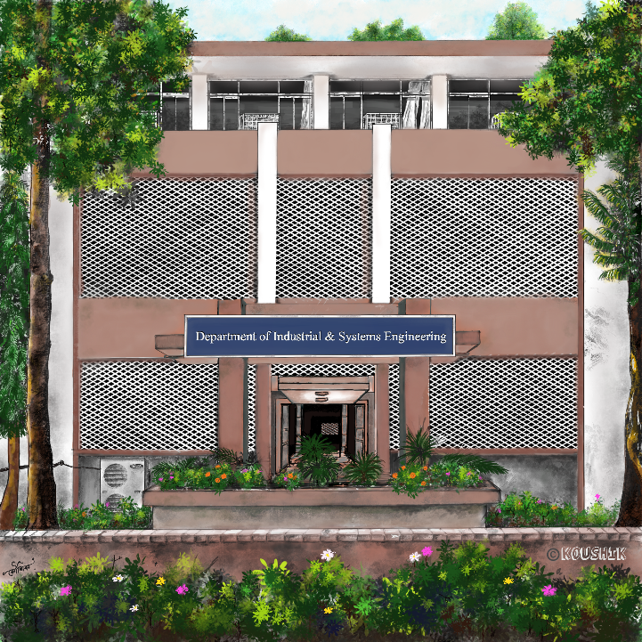

PRIVATE AND PERMISSIONED BLOCKCHAIN FOR SUPPLY CHAIN
Seminar
Session 2024-2025, Department of Industrial and Systems Engineering,
Indian Institute of Technology Kharagpur.
Submitted to
Prof. Mamata Jenamani
Shivani Kesharwani (24IM61R08) Dhruva S Kashyap (24IM61R05)
M.Tech 1st Year
Department of Industrial and Systems Engineering
IIT Kharagpur.

Slide 2
CONTENTS
Introduction and motivation
Problem description
Literature review and gap identification
Proposed model/data description
Model implementation
Results and discussion
Conclusions and future scope

Slide 3
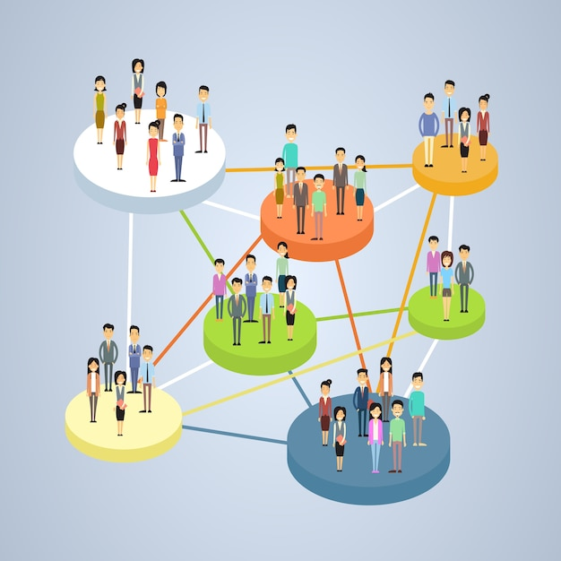
INTRODUCTION
Private Blockchain Access to Limited Participants, ensuring confidentiality and control.
Security Enhanced control and security due to limited access, protecting sensitive supply chain data.
Permissioned Blockchain Different levels of access or roles are provided to users, enhancing operational flexibility.

Slide 4
Benefits of Blockchain in Supply Chain
Enhanced Transparency All participants have access to the same data, reducing discrepancies and fraud
Improved Traceability Products can be tracked from origin to consumer, ensuring authenticity
Cost Reduction Streamlined Process reduce the need for intermediaries lowering costs

Slide 5
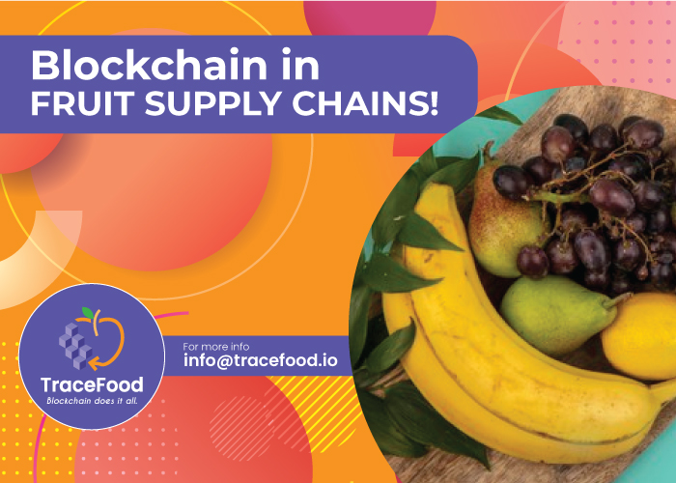
Use Case of Blockchain in the Fruit Supply Chain
Streamlined Payments
Tracking Products
Authenticity Verification

Slide 6
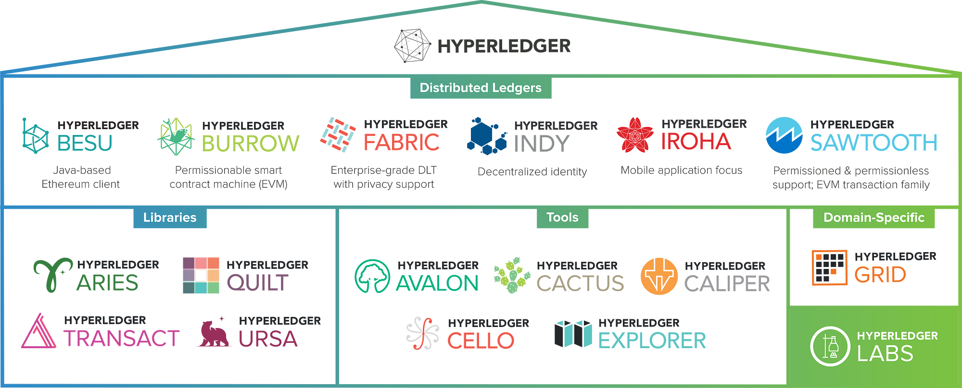
Notes:
There is a project called Hyperledger. There are lot of frameworks under the roof of Hyderledger.

Slide 7
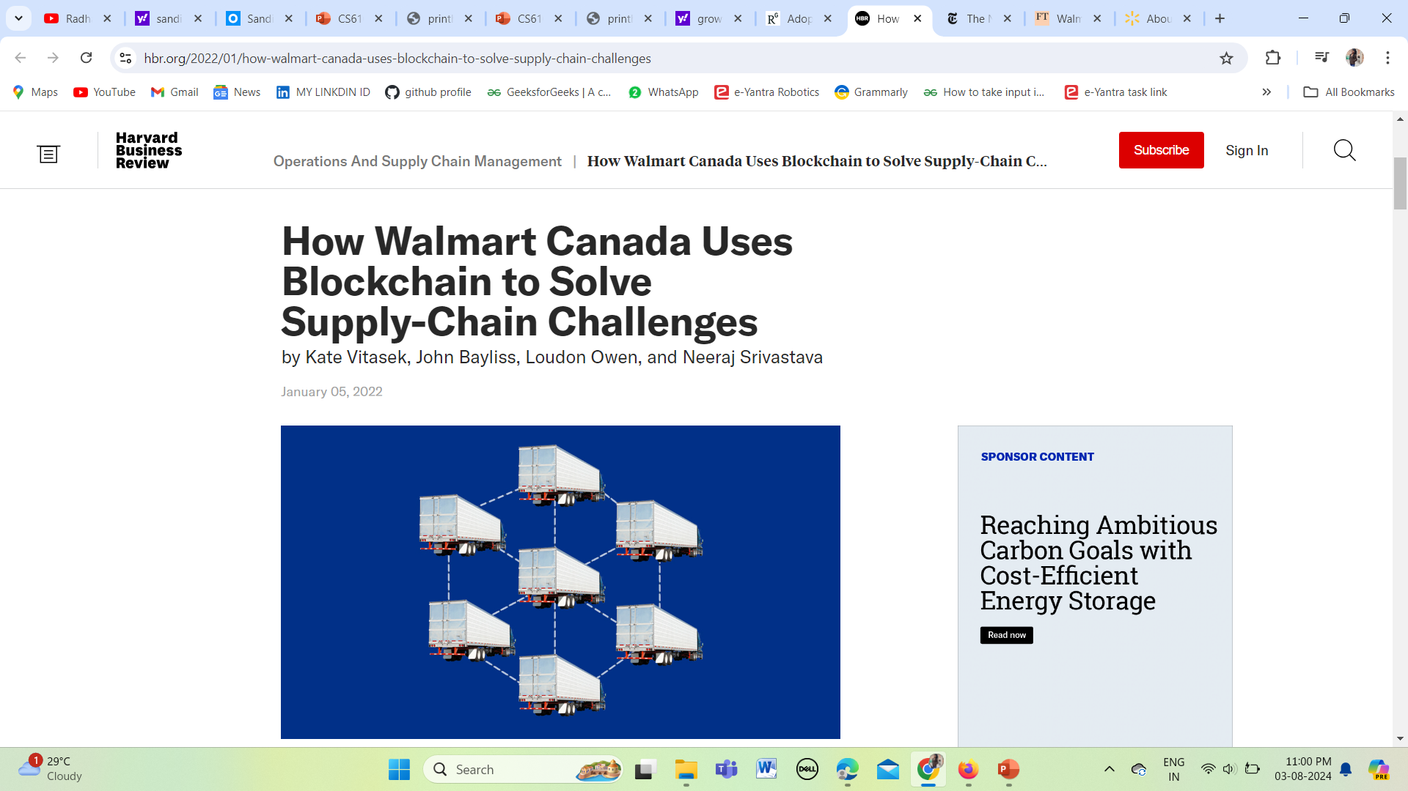
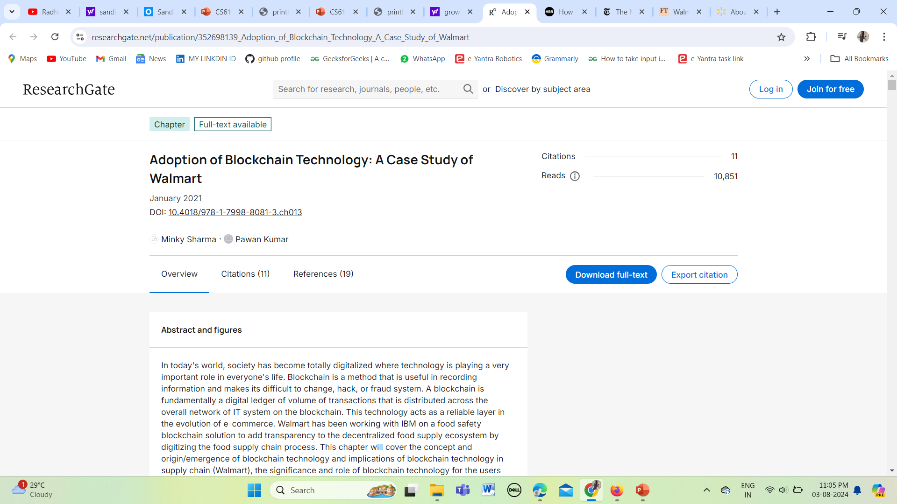
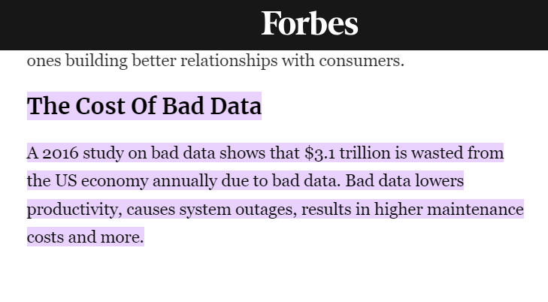
MOTIVATION
And the news and articles ……
Source- https://www.researchgate.net/publication/352698139_Adoption_of_Blockchain_Technology_A_Case_Study_of_Walmart
Minky Sharma https://orcid.org/0000-0002-9956-6754 Chandigarh University, India Pawan Kumar Chandigarh University, India
This article discusses how poor data quality affects decision-making and operational efficiency.
Source- https://hbr.org/2022/01/how-walmart-canada-uses-blockchain-to-solve-supply-chain-challenges

Slide 8
PROBLEM DESCRIPTION
Lack of trust among all stakeholders (Francisco and Swanson, 2018)
Less transparency and productivity (Kshetri, 2018)
FRUIT SUPPLY CHAIN
Efficiency at each level cannot be tracked [Huo (2012), Zheng et al. (2018)]
Lack of integration at all levels (Pasi st al, 2020)

Slide 9
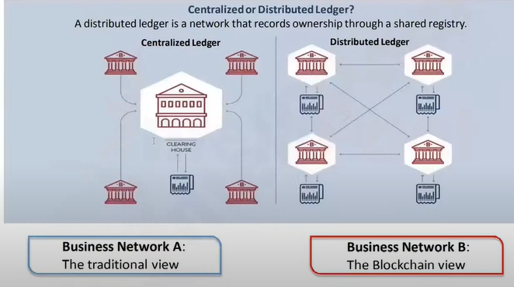
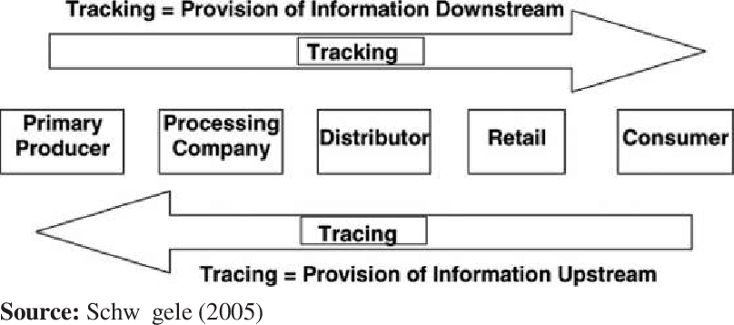
Fruit Supply Chain Workflow
Traditional v/s Blockchain business network

Slide 10
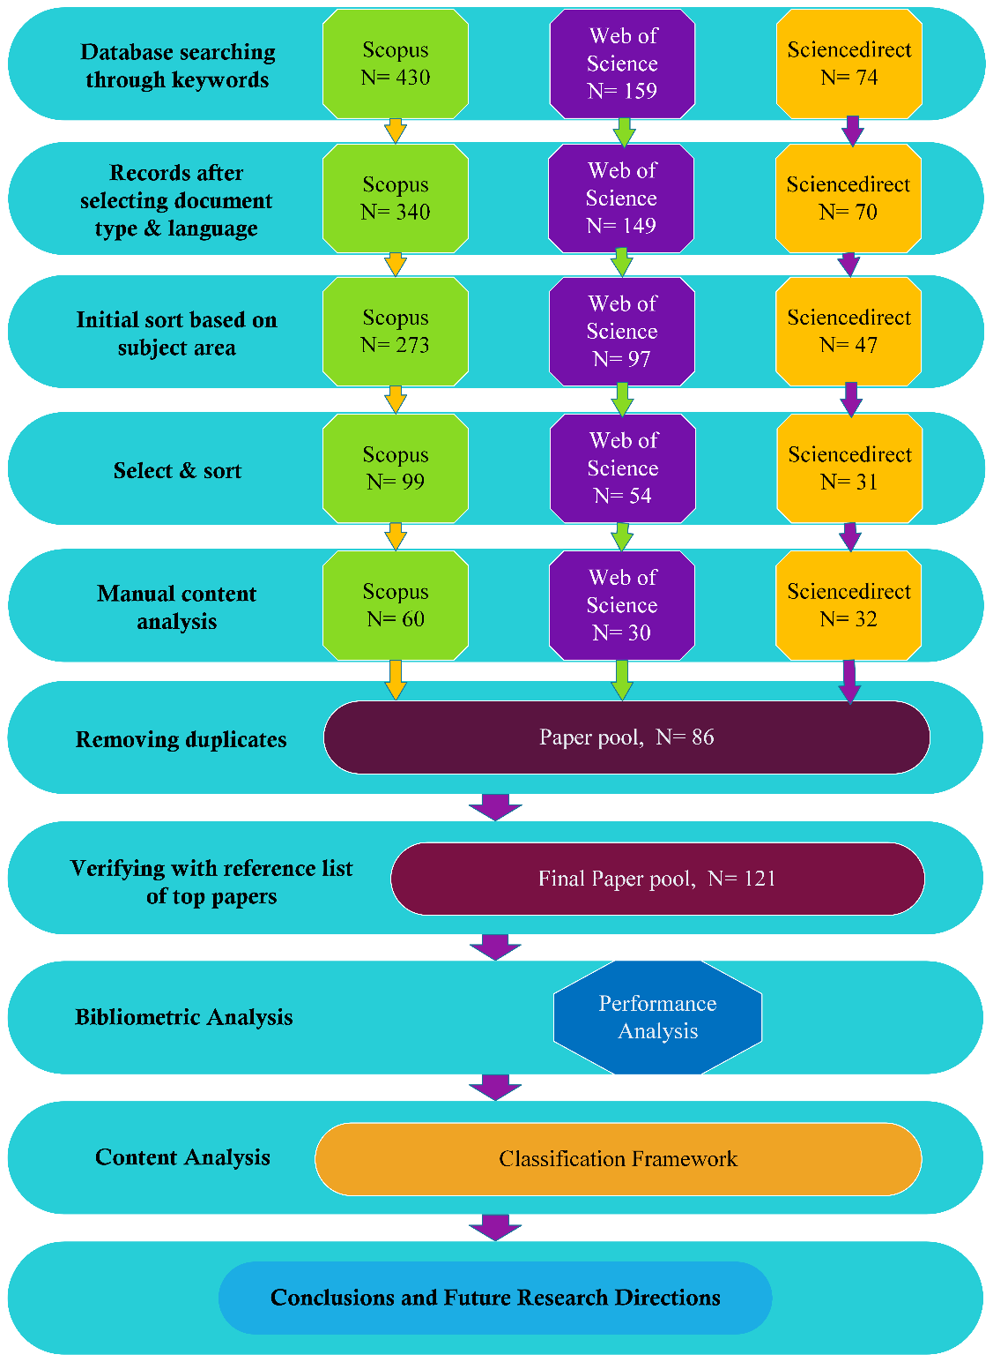
LITERATURE REVIEW
Table 1. Stages involved in the selection of articles for this Study
Stages | Details
Keyword Search | Boolean search: ((“blockchain" AND “supply chain"). Search Databases: SCOPUS, WEB OF SCIENCE and SCIENCEDIRECT. Search space: “Title OR Abstract OR Keywords”. Time range: Published from January 1, 2010 to May 10, 2023.
Document type and language | Select only journal articles in the English Language.
Initial Sort | Shrinking the pool of papers based on the subject area.
Select and Sort | Inclusion criterion: Articles should be published in peer-reviewed journals as per ABDC/ABS ranking. For other journals: dedicated to retailing and consumer services are selected (H index and SCImage ranking were considered).
Manual content analysis | Quick content check of individual papers independently and finalize the pool of papers from each database.
Removal of Duplicates | Combine the final papers from three databases and remove the duplicates to get the final paper pool for our study.
Verifying with reference list of top papers | Cross checking the reference list of prominent papers and relevant literature reviews to find out and add any relevant missing papers.
Figure 1. The systematic review methodology

Slide 11
LITERATURE REVIEW
Key Literature on Supply Chain (Fruit Supply Chain) with Emerging technology Blockchain
Author (Year) | Objective | (M) Methodology and (A) Analysis | (F) Key Findings and (L) Limitations and Future Scope
Muhammad Islam, Jinjun Chen & Mubashir Husain Rehmani (Feburary 2024) | Differentially private enhanced permissioned blockchain for private data sharing in industrial IoT. | (M) Using algorithms for data sharing (A) Multichannel Mechanism | (F) Permissioned blockchain such as HF and IIoT has opened new opportunities for interdependent supply chain partners. (L) Classify the adversaries based on the threat level.
Yingli Wang,Meita Singgih,Jingyao Wang,Mihaela Rit (2019) | Making sense of blockchain technology: How will it transform supply chains? | (M) Expert interviews. (A) Content analysis of Experts. | (F) Improve efficiency in logistics and supply chains, since the technology accelerates the transfer of data streams between parties. (L) Alternative methods such as the Delphi technique could be deployed for a more structured way of assessing and combining experts' judgements.

Slide 12
LITERATURE REVIEW
Key Literature on Supply Chain (Fruit Supply Chain) with Emerging technology Blockchain
Author (Year) | Objective | (M) Methodology and (A) Analysis | (F) Key Findings and (L) Limitations and Future Scope
Bin Yu,Ping Zhan, Ming Lei, Fang Zhou, Peng Wang (2020) | Food Quality Monitoring System Based on Smart Contracts and Evaluation Models | (M) Uses HCA, PCA, and PLSR to conduct an analysis. (A) Prototype version of the quality monitoring system for flat-peach juice production | (F) Use FARM for quality analytics; QEC adjusts the production process if results are unsatisfactory. (L) Lacks traceability; process control focuses on product characteristics, not process parameters.
Paolo Bottoni, Nicola Gessa, Gilda Massa, Remo Pareschi, Hesham Selim, Enrico Arcuri (2020) | Intelligent Smart Contracts for Innovative Supply Chain Management | (M) Smart contracts to manage revenue sharing. (A)Enhance interorganizational trust and coordination in supply chains. | (F) Improve efficiency in logistics and supply chains, since the technology accelerates the transfer of data streams between parties. (L) Alternative methods such as the Delphi technique could be deployed for a more structured way of assessing and combining experts' judgements.

Slide 13
RESEARCH GAPS
From the literature review, the research gaps are as follows:
Managing data privacy and ownership rights in private and permissioned blockchains, particularly in sensitive industries where data is shared among multiple parties.
What are the challenges to blockchains' further diffusion in supply chains?

Slide 14
RESEARCH QUESTION
The research question posed for the present study are as follows.
How can HyperLedger Fabric perceived to benefit of supply chain?

Slide 15
OBJECTIVES
To answer the above research questions, the following objectives are laid out:
By providing a transparent, immutable ledger that ensures authenticity and fosters trust among participants. Its secure channels and strong access controls protect sensitive information, thereby increasing overall security in the supply chain.

Slide 16
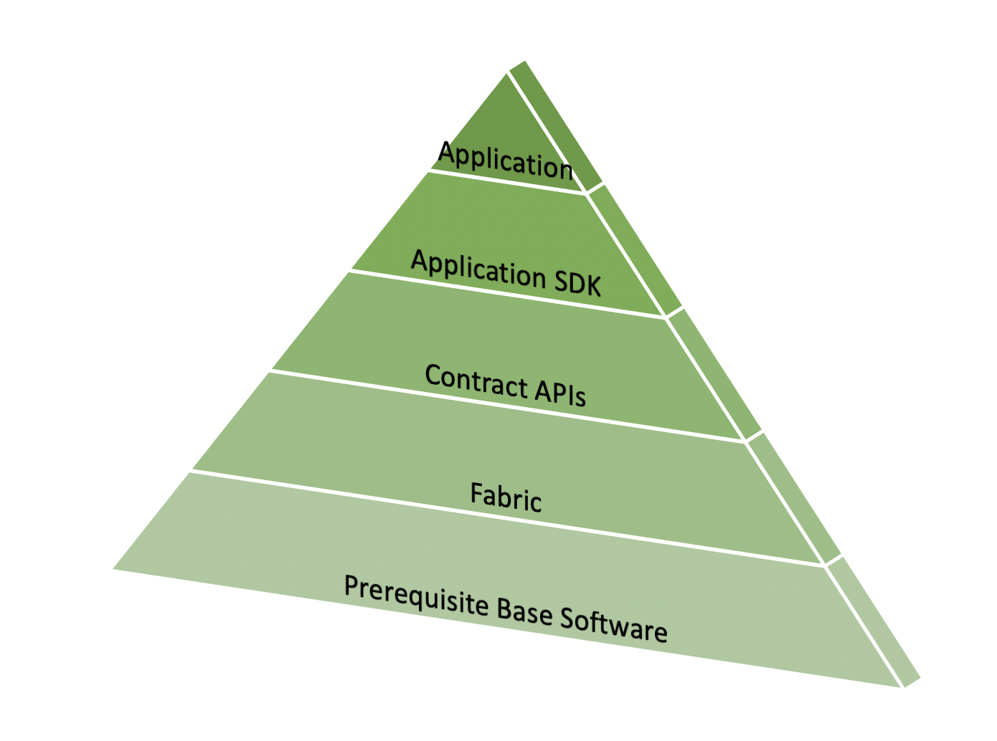
PROJECT METHODOLOGY
Hyperledger Fabric Network Setup(Virtual Machine)
Creating Directory
Fabric Installation
npm install npm start (Channel is ready for transaction)
Writing Command for Application Terminal
Install Docker Libraries
Creating Test-Network & Channel (CouchBD)
Deploying ChainCode
Figure 3. Methodological Framework (source: Hyperledger Fabric)

Slide 17
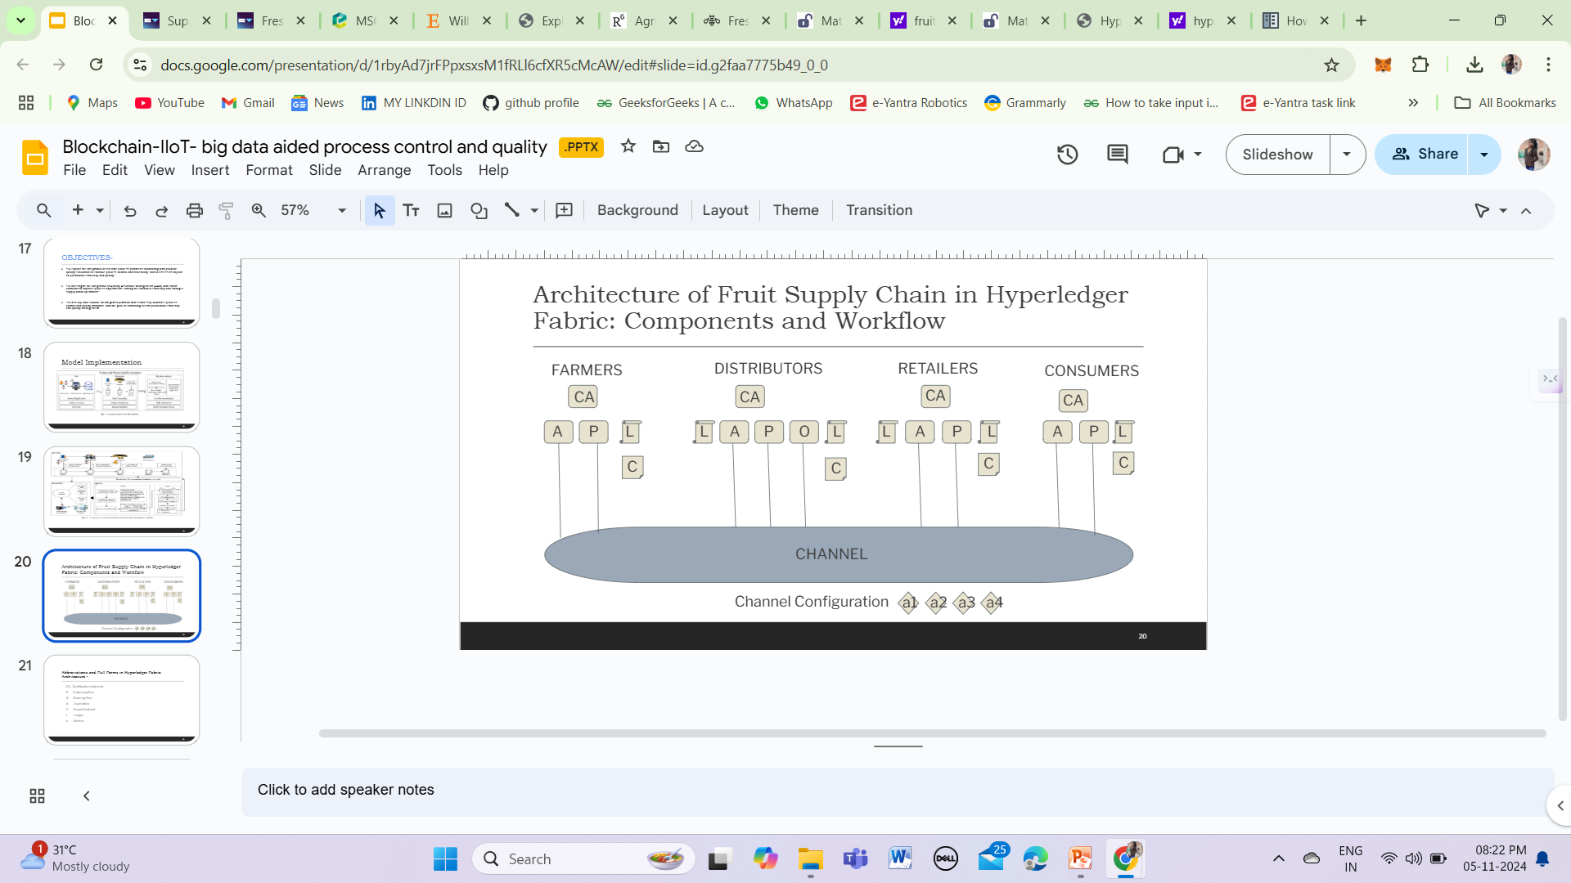

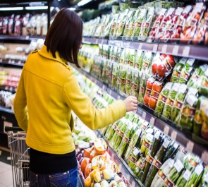
PROPOSED MODEL
Architecture of Fruit Supply Chain in Hyperledger Fabric: Components and Workflow
CA - Certification
Authority
P - Endorsing Peer
O - Ordering Peer
A - Application
C - Smart Contract
L - Ledger
a - Admins

Slide 18
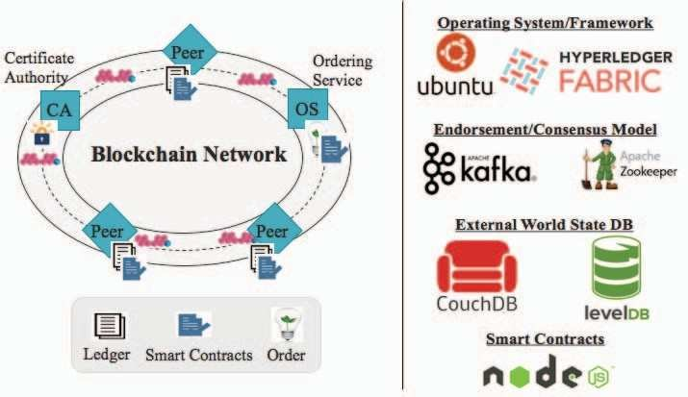
PROPOSED MODEL
(source: Hyperledger Fabric)

Slide 19
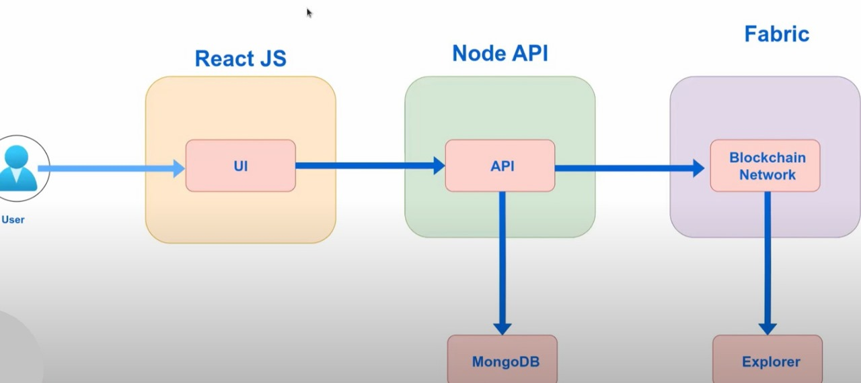
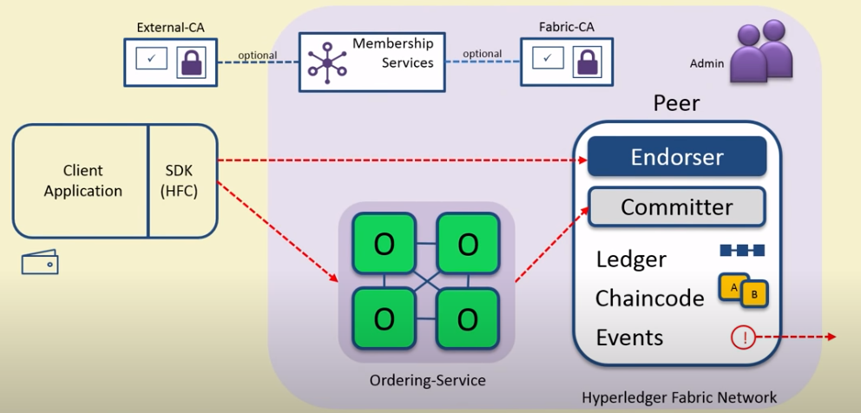
PROPOSED MODEL
Components of the Network
Entities Involved
(source: Hyperledger Fabric)

Slide 20
WHY HYPERLEDGER FABRIC?
Some of the key features required for a supply chain are:
Private, Permissioned Network: Access is restricted to trusted participants, fitting supply chain needs.
Modular Architecture: Adaptable to different business requirements, easy integration with existing systems.
Data Privacy: Channels and policies ensure each role accesses only the necessary information, maintaining confidentiality.

Slide 21
OVERVIEW OF PROPOSED MODEL (DATA DISCRIPTION)
The various participants in our model are:-
Farmer: Registers details on harvested crops.
Distributor: Logs transport details and conducts quality checks.
Retailer: Manages inventory from distributors and verifies product origin.
Customer: Gains visibility into the origin and journey of fruits.
Admin (optional): Manages the network and monitors participant activities.

Slide 22
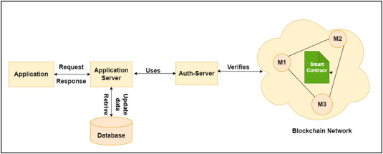
OVERVIEW OF PROPOSED MODEL
Data Access Model:
Farmer View: Limited to registering and managing their crop data.
Distributor View: Access to transport records and quality checks.
Retailer View: Can view the supply chain history of products they manage.
Customer View: Public, read-only access to verify product origins and quality.
Admin View: Full network monitoring, role management, and oversight.
(source: Hyperledger Fabric)

Slide 23
OVERVIEW OF PROPOSED MODEL
Farmer’s Datamodel:
Farmer:
FarmerID (Primary Key): Unique identifier for each farmer.
Name: Farmer’s name.
Location: Farm location details.
Crops: List of crop batches linked to this farmer.
CropBatch:
BatchID (Primary Key): Unique identifier for each crop batch.
FarmerID (Foreign Key): Links to the farmer who registered this crop.
CropType: Type of crop (e.g., apples, bananas).
HarvestDate: Date when the crop was harvested.
Quantity: Amount of crop in the batch.
QualityStatus: Quality assessment status (pending, approved, or rejected).
TransactionHistory: Log of all transactions and status updates for this crop.

Slide 24
OVERVIEW OF PROPOSED MODEL
Farmer’s Chaincodes:
RegisterCrop:
Purpose: Allows farmers to register a new crop batch, entering data like crop ID, harvest date, quality metrics, and location.
Execution: When executed, this function adds a new record to the blockchain, marking the beginning of the crop’s traceability journey.
UpdateQualityMetrics:
Purpose: Lets farmers update quality information (e.g., pesticide residue, grading) post-harvest.
Execution: This function allows farmers to provide transparency around the product’s quality.

Slide 25
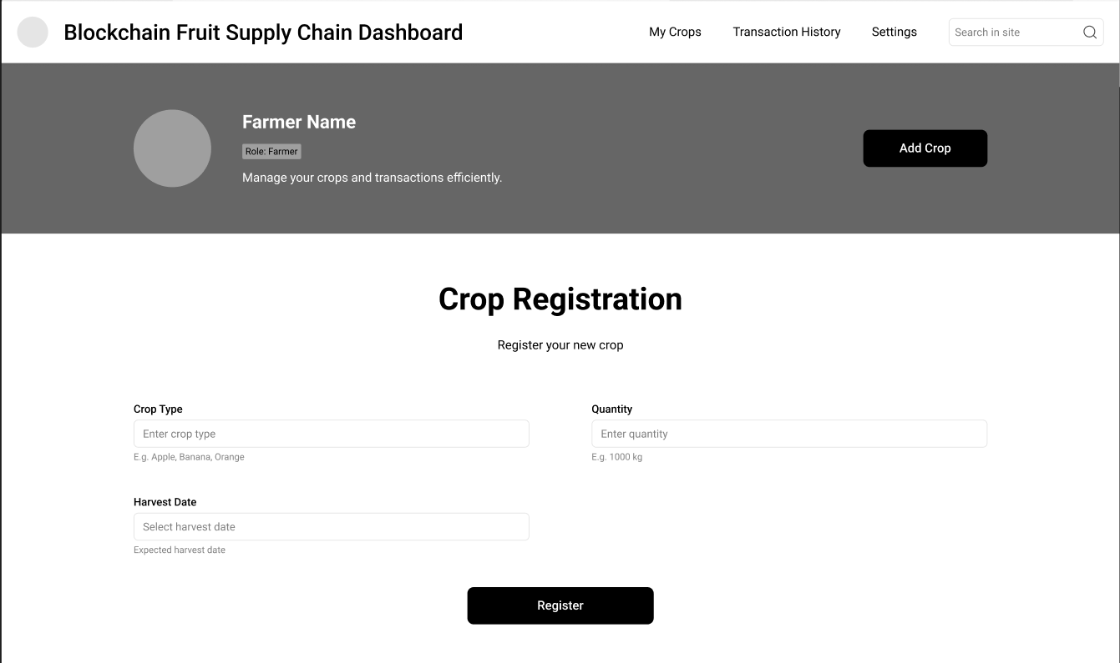
OVERVIEW OF PROPOSED MODEL

Slide 26
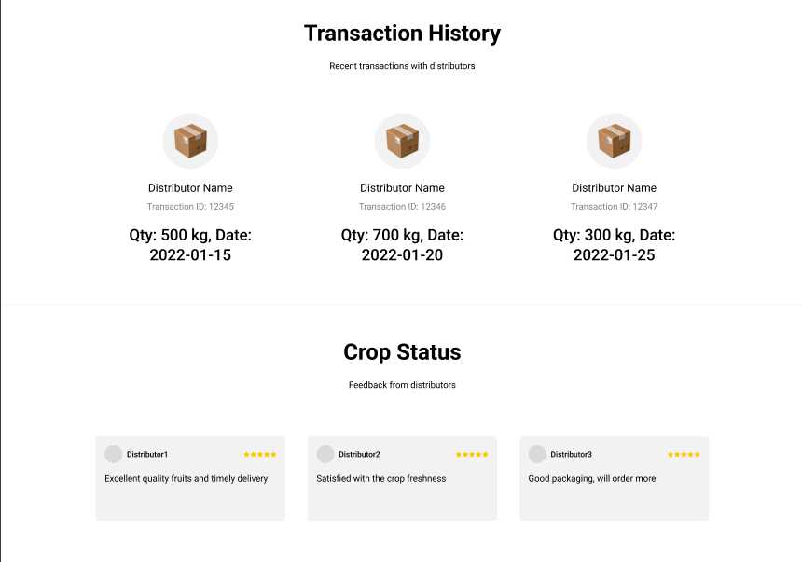
OVERVIEW OF PROPOSED MODEL

Slide 27
OVERVIEW OF PROPOSED MODEL
Distributor Datamodel:
TransportID: Unique identifier for each transportation event.
CropID: References the crop batch being transported.
TransportDate: Date of dispatch.
TemperatureControl: Data related to refrigeration or temperature settings during transport.
Origin and Destination: Locations from where the crop is picked up and delivered.

Slide 28
OVERVIEW OF PROPOSED MODEL
Distributor Chaincode:
TransportCrop:
Purpose: Distributors use this chaincode to record transportation details, linking the crop ID to transport events.
Execution: Logs the start and end points of transport, temperature control settings, and ensures these updates are recorded on the blockchain for traceability.
InspectQualityPostTransport:
Purpose: Records any inspections done after transport to verify the product's condition upon arrival.
Execution: Adds a timestamped record, giving retailers and customers insight into post-transport quality.

Slide 29
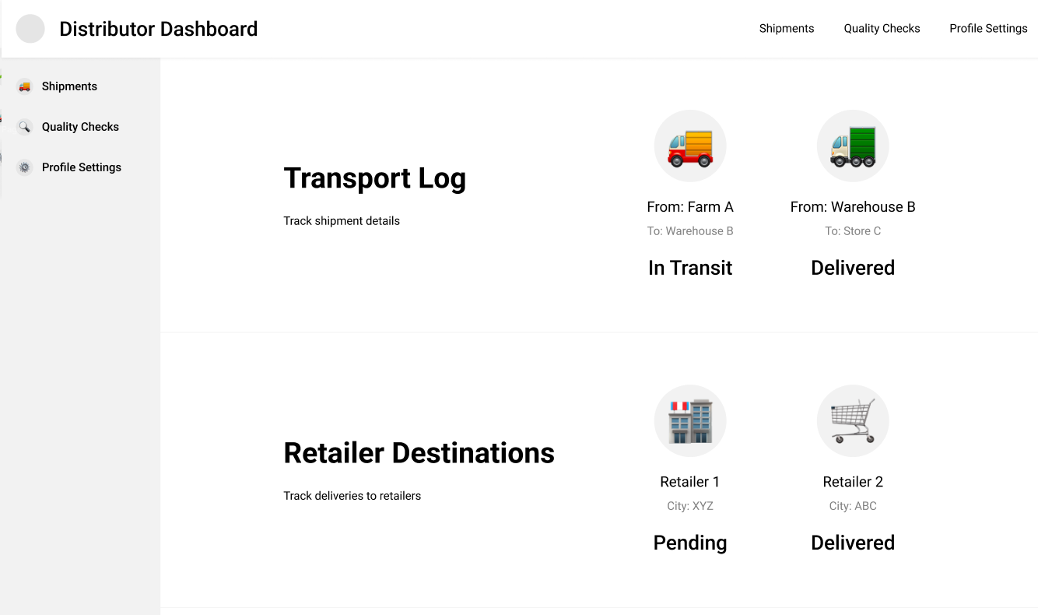
OVERVIEW OF PROPOSED MODEL

Slide 30
OVERVIEW OF PROPOSED MODEL
Retailer Data Model
InventoryID: Unique identifier for each inventory batch.
CropID: Links the retailer’s inventory to the original crop batch.
ShelfLife: Predicted expiration date, helping with inventory rotation.
CurrentStock: Quantity in stock.
ReceivedDate: Date the crop batch was received at the retailer’s location.

Slide 31
OVERVIEW OF PROPOSED MODEL
Retailer Chaincode:
ReceiveInventory:
Purpose: Allows retailers to log received crop batches in their inventory, recording stock level, shelf life, and received date.
Execution: This function updates the blockchain with retailer-specific inventory information, enabling easy tracing back to the original crop batch.
UpdateShelfLife:
Purpose: Allows retailers to adjust shelf life estimates based on conditions or storage changes.Execution: Helps retailers maintain quality by tracking inventory expiration dates.or storage changes.
Execution: Helps retailers maintain quality by tracking inventory expiration dates.

Slide 32
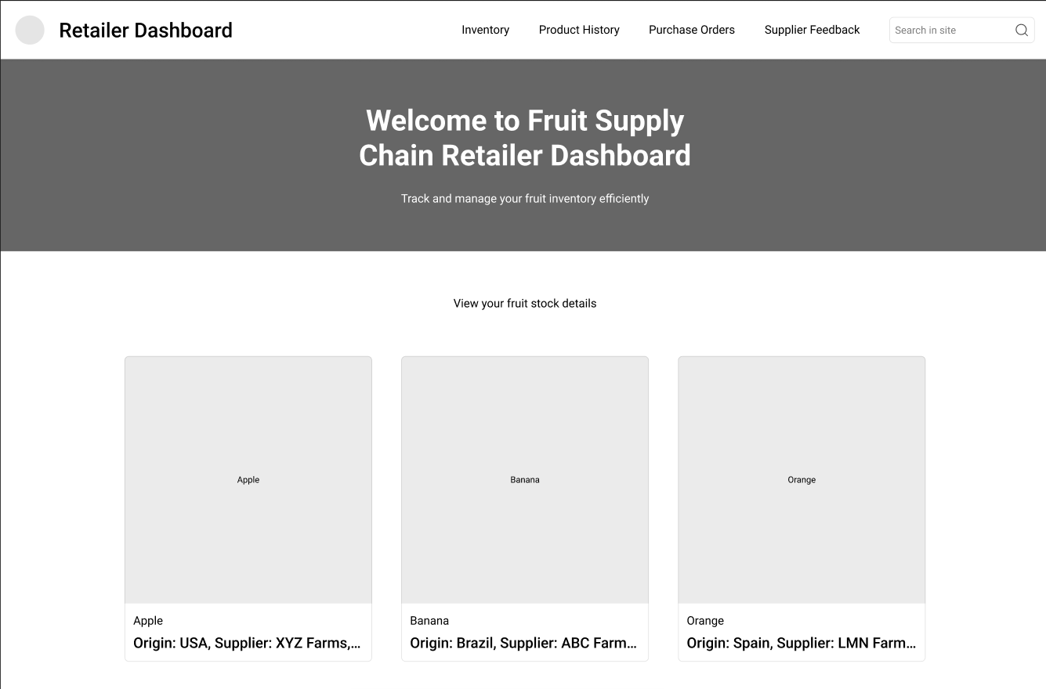
RESULTS & DISCUSSION

Slide 33
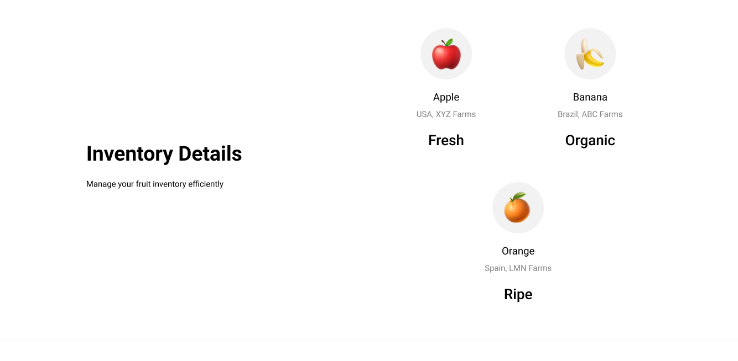
USER INTERFACE REPERSENTATION OF BLOACKCHAIN NETWORK

Slide 34
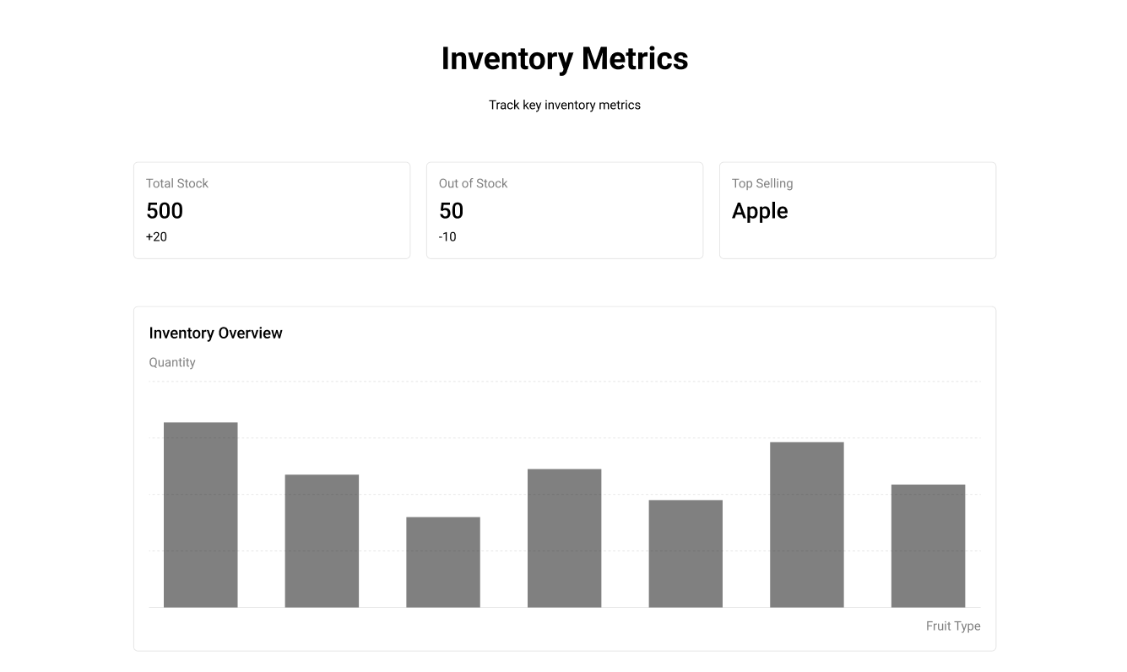
USER INTERFACE AT DISTRIBUTOR END

Slide 35
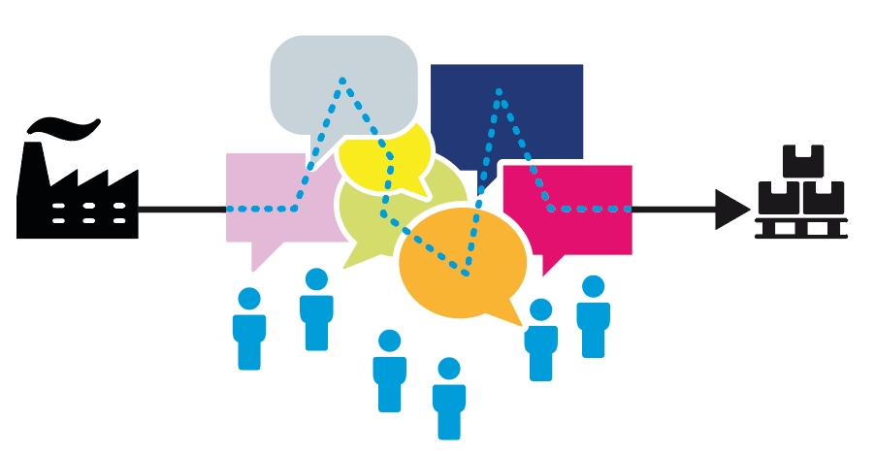
BLOACKCHAIN NETWORK DATA AT CUSTOMER END
Customer Data Model:
PurchaseID: Unique identifier for each purchase.
CropID: Refers back to the original crop ID for traceability.
PurchaseDate: Date the customer bought the product.
Feedback: Optional field for customers to submit feedback on quality.

Slide 36
OVERVIEW
Customer Chaincodes:
VerifyProduct:
Purpose: Customers use this function (usually via an app) to pull data on product origin and quality.
Execution: Fetches data across the farmer, distributor, and retailer records to provide the customer with a complete view of the product’s journey.
SubmitFeedback:
Purpose: Lets customers provide feedback on quality or other experiences.
Execution: Records customer feedback, which can later be accessed by other participants to improve product handling and quality.

Slide 37
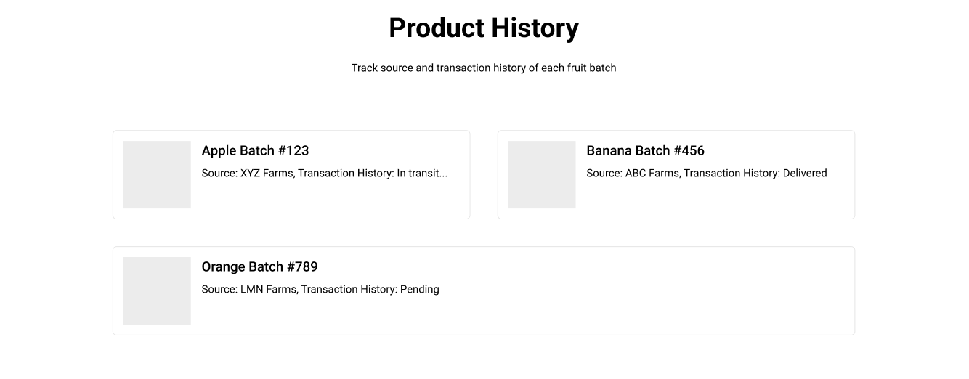
TRACKING REPORT

Slide 38
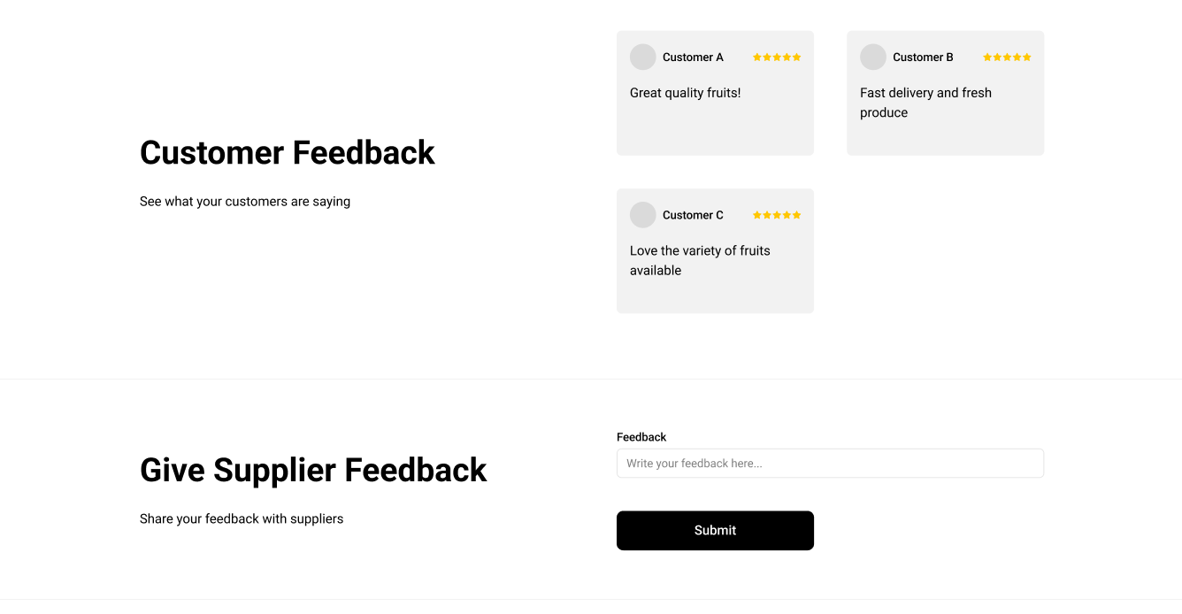
OVERVIEW

Slide 39
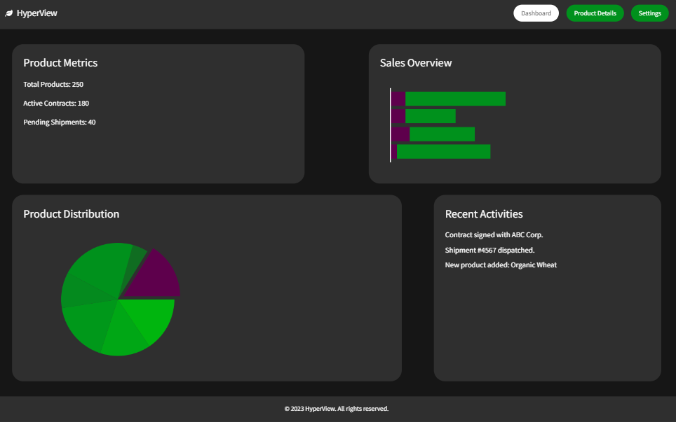
ADMIN VIEW

Slide 40
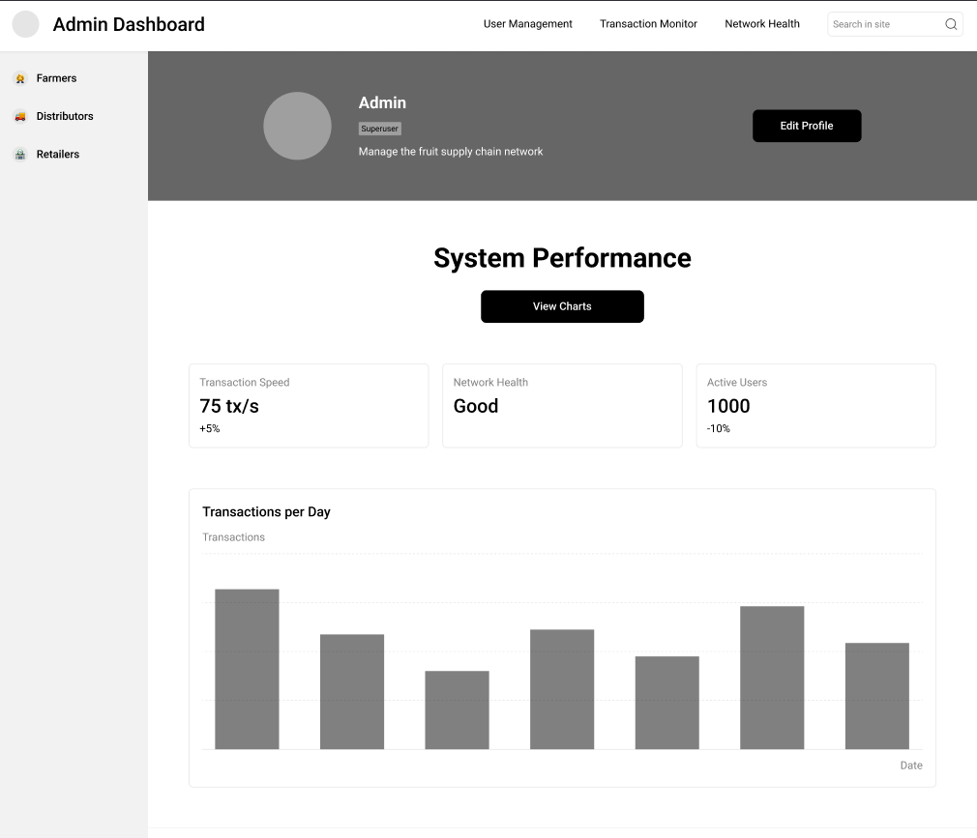
ADMIN VIEW

Slide 41
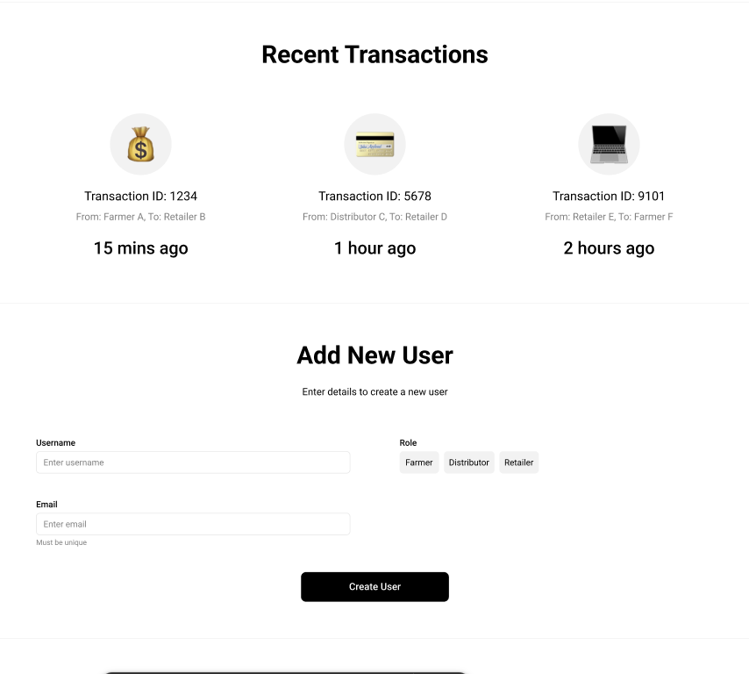
RESULTS & DISCUSSION (ADMIN VIEW)

Slide 42
CONCLUSION & FUTURE SCOPE
Future Implementation Ideas:
Advanced Analytics: Use accumulated data to optimize demand forecasting, transportation efficiency, and logistics.

Slide 43
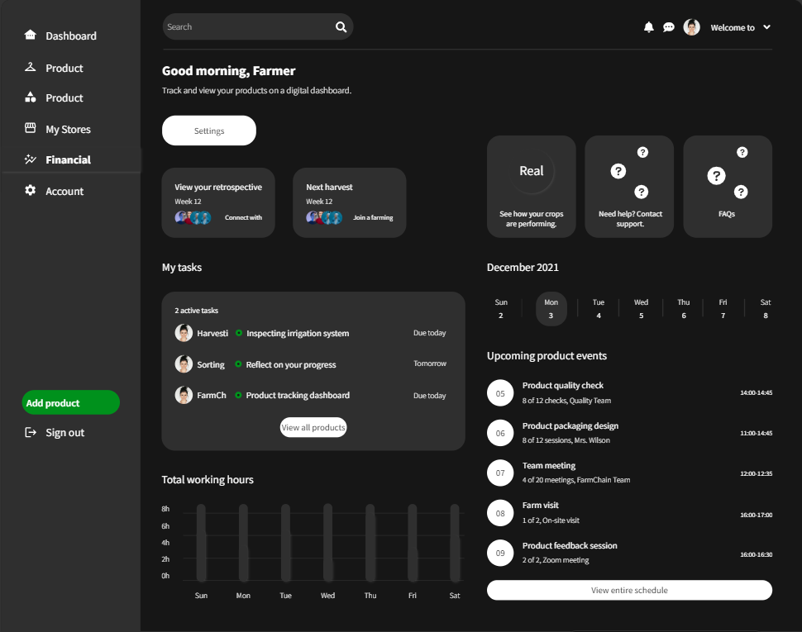
FUTURE SCOPE

Slide 44
FUTURE SCOPE
Future Implementation Ideas:
IIoT Integration: Incorporate real-time sensors to automate data capture, such as temperature for quality monitoring..

Slide 45
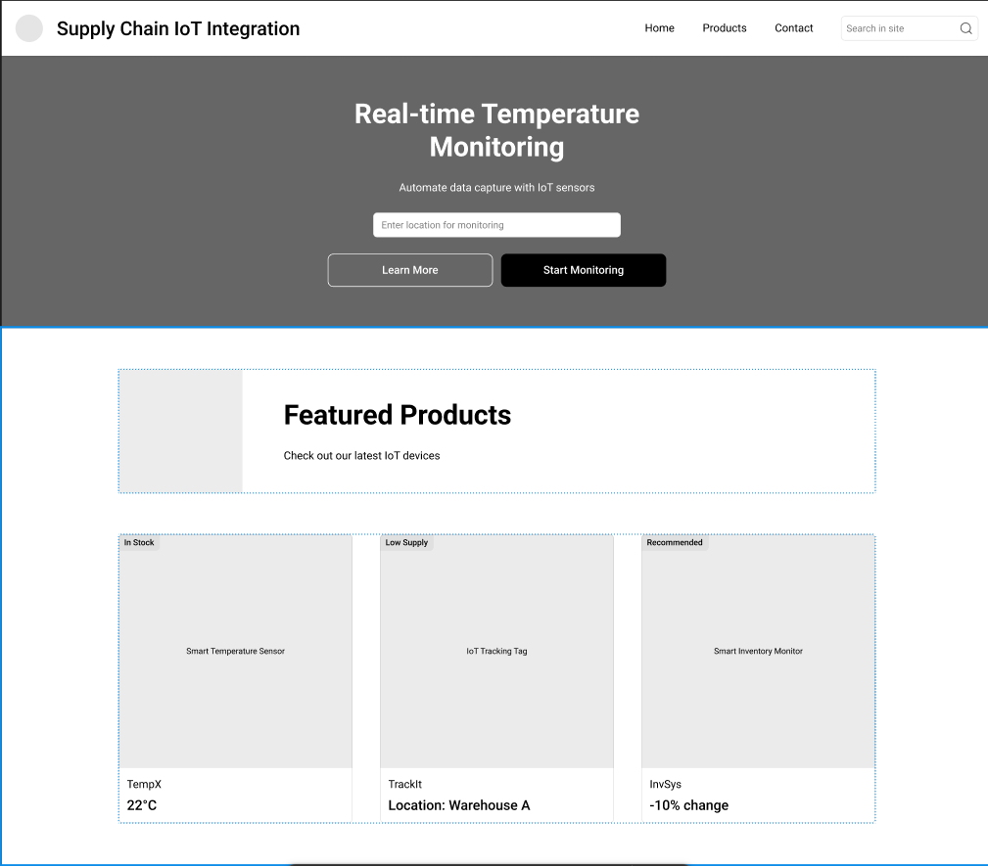
FUTURE SCOPE

Slide 46
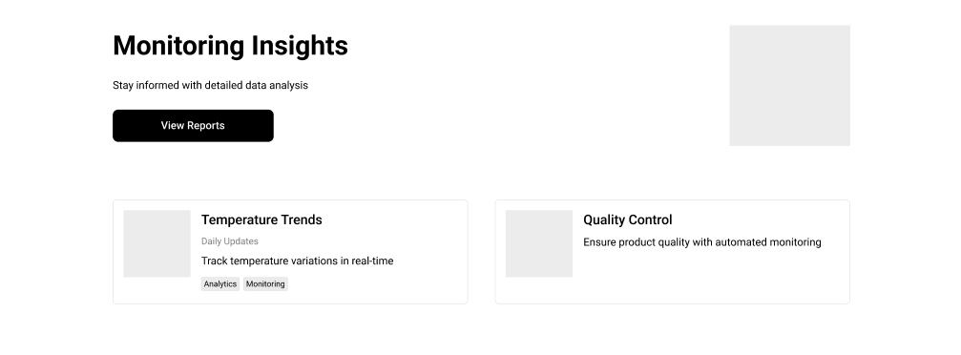

FUTURE SCOPE

Slide 47
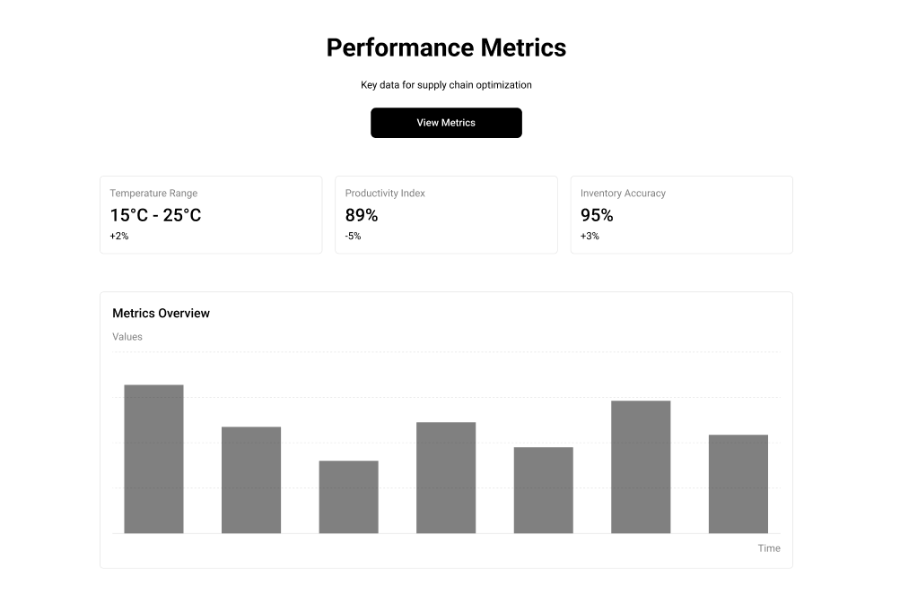
FUTURE SCOPE

Slide 48
REFERENCES
Muhammad Islam, Jinjun Chen & Mubashir Husain Rehmani (Feburary 2024) , Differentially private enhanced permissioned blockchain for private data sharing in industrial IoT.
Yingli Wang,Meita Singgih,Jingyao Wang,Mihaela Rit (2019), Making sense of blockchain technology: How will it transform supply chains?
Bin Yu,Ping Zhan, Ming Lei, Fang Zhou, Peng Wang (2020) , Food Quality Monitoring System Based on Smart Contracts and Evaluation Models
Paolo Bottoni, Nicola Gessa, Gilda Massa, Remo Pareschi, Hesham Selim, Enrico Arcuri (2020), Intelligent Smart Contracts for Innovative Supply Chain Management.
R.D. Snee, R.W. Hoerl, J.R. Rodriguez (2010), Quality by Design in Pharmaceutical Development and Manufacturing: A Case Study Approach.
Escobar, C.A.; McGovern, M.E.; Morales-Menendez, R (2021), Quality 4.0: A Review of Big Data Challenges in Manufacturing
https://hyperledger-fabric.readthedocs.io/en/latest/fabric_model.html
https://tech.walmart.com/content/walmart-global-tech/en_us/blog/post/blockchain-in-the-food-supply-chain.html#
https://insights.encora.com/insights/car-supply-chain-on-hyperledger-fabric-blockchain

Slide 49

Thank you
Shivani Kesharwani (24IM61R08)
Dhruva S Kashyap (24IM61R05)
M.Tech 1st Year
Department of Industrial and Systems Engineering
IIT Kharagpur.

